Slide 1


April 26, 2013
Team Panda
Blayne Kennedy, Kimberly Oyama, Daren Rodhouse, Chihiro Sasaki

Slide 2


Kimberly Oyama

Slide 3


Joshua Cross
Founder, CEO at Hermes Commerce, Inc.
Application Development
Notes:
kimi

Slide 4

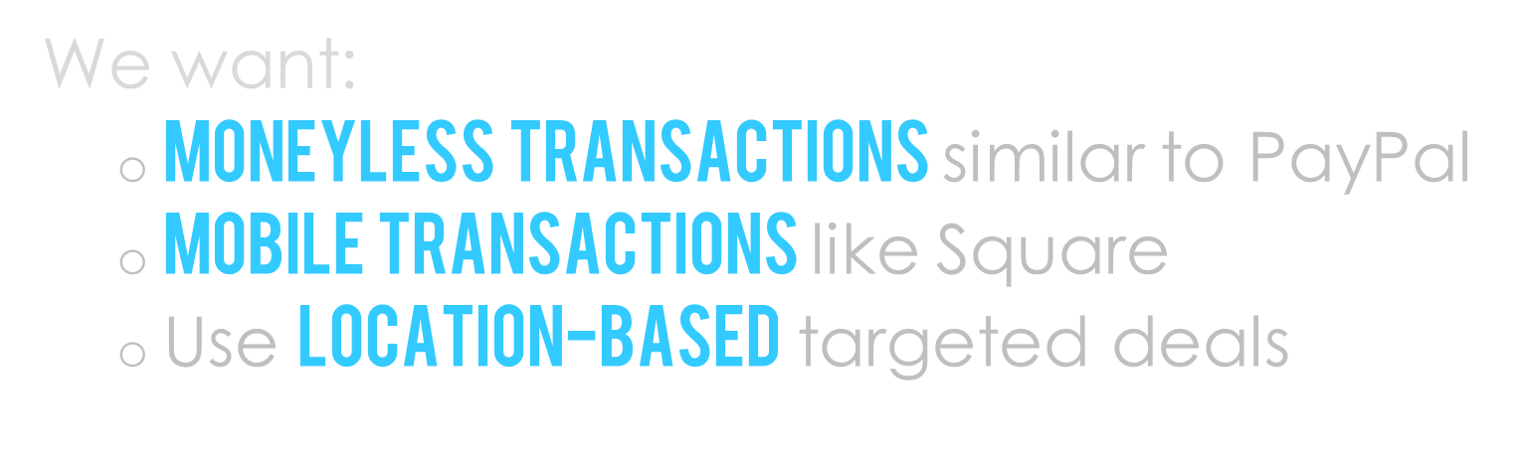
Notes:
kimi

Slide 5



Direct Deals
+
Notes:
Connect merchant and customer so the merchant can charge the customer.
Use previous transactions, demographics, and user location for targeted advertising.
Kimi
Your vision: was it compelling, did it evoke confidence
and suggest creativity? Did it get us motivated to listen to the rest of the talk?
Your vision. Should address precisely the problems you just
mentioned. Grading: was it compelling, did it evoke confidence and suggest creativity?
Did it get us motivated to listen to the rest of the talk?

Slide 6


Daren Rodhouse

Slide 7

Group Brainstorming
Group consensus
Compose questions
Initial Client Meeting
Lay out group's understanding of project
Client molds understanding
Follow-Up Client Meetings
Go over requirements document
Notes:
Daren
risks
Privacy protection on apps
Content filter
No cell service
Inaccurate geolocation
MCM server failure

Slide 8

Customer/Merchant Interfaces
Mobile devices
Website
Basic functionality
Request/accept payment
Change settings
Ads, coupons, location, account
Merchant map
Notes:
daren

Slide 9
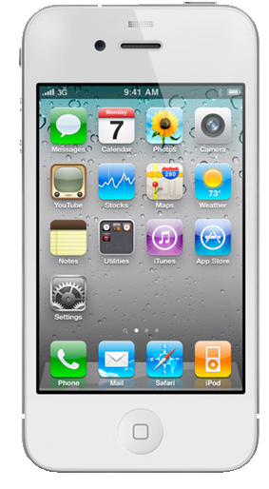
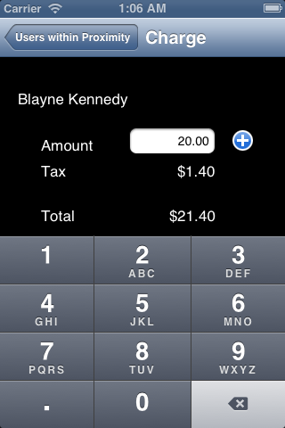


Customer/Merchant apps must communicate with each other
Merchant charges customer
Customer is notified
Customer replies
2
1
Server
3

Slide 10
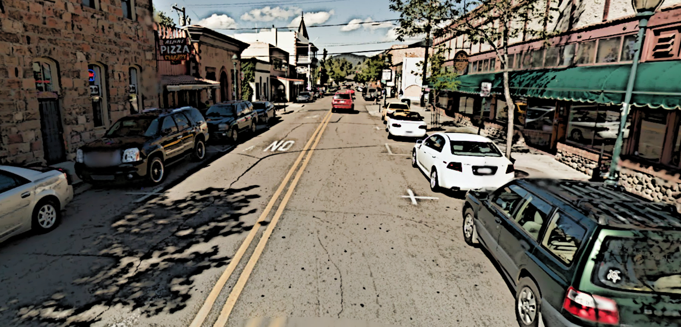
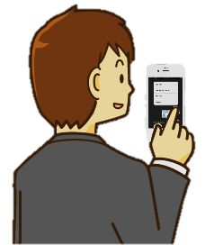
Meaningful Advertisements
Pushed based on location/demographic
user inputs destination
user gets notification about ads/coupons from nearby locations and subscribed merchants nearby

Slide 11

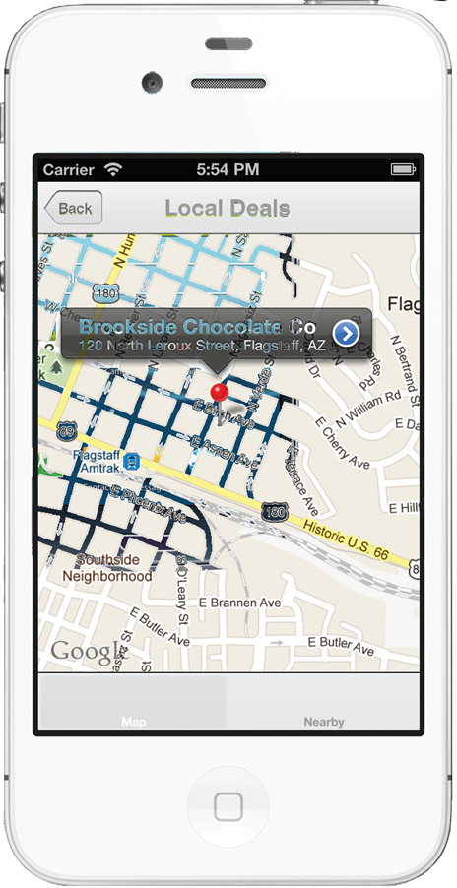
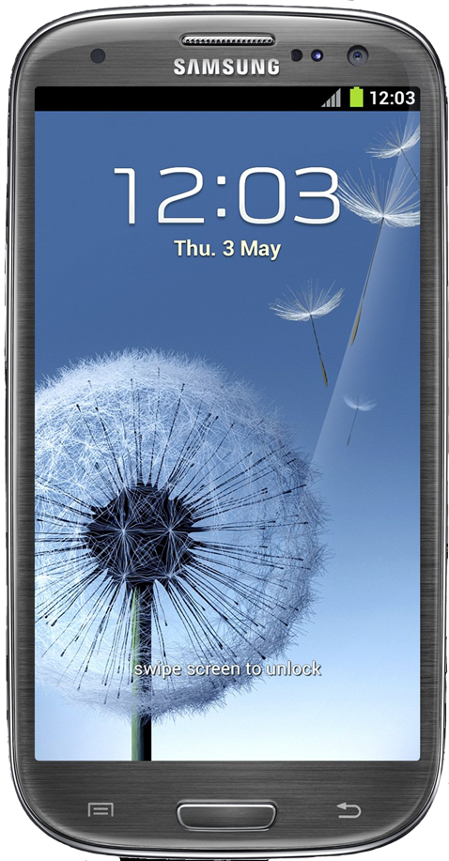
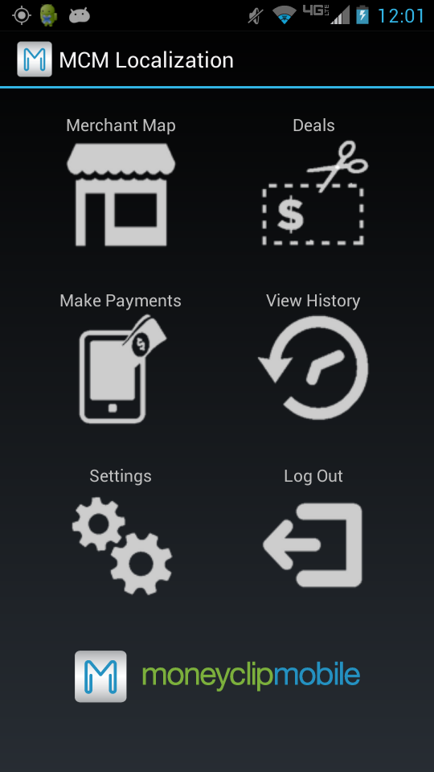
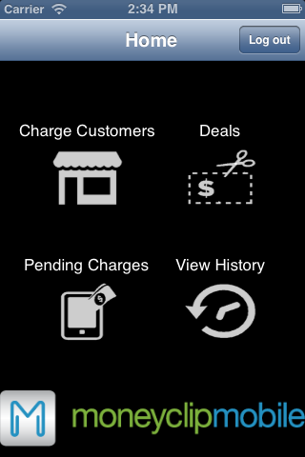
Cross-platform
Usability
Reliability
Performance
Accessibility
Scalability
Notes:
daren

Slide 12

Android Devices
Operating System Fragmentation
Java and XML
iPhone Devices
Objective-C
Google Maps API
Timely Advertisements
Notes:
Daren

Slide 13

Target Platforms
Android 4.2
iOS 5
Localization
Google Maps API
Network provider or GPS
Server
RESTful Web Services
MySQL
Notes:
Blayne
Should be focal point of this presentation. Review
progress implementing various parts of the architecture previewed above --- hopefully
more or less DONE at this point. Give demos or screenshots where appropriate.

Slide 14

Database
Update location, update transaction
List of customers, list of charges
Merchant App
Charge customer
RESTful Web Service
Update location
CustomerApp
JSON
JSON
List of nearby customers
Charge notification
Notes:
The first core functionality of localization is the connection between the merchant and the customer in the store.
When the customer walks into the store, they are able to update their location, which happens as an HTTP Request to the web service, where information is sent as a JSON string. Next, the merchant is notified of the customer in the store. When a purchase is going to be made, the merchant can push a charge to the customer. This charge goes through the web service, updates the database, and the user is then notified of a new charge. The customer can then approve or decline the charge, depending on the situation, and this information is again sent to the web service, and the merchant can confirm that the charge has been made.
Google Cloud Messaging
Apple Push Notification Service

Slide 15

Database
Query for subscribed deals
List of subscribed deals
RESTful Web Service
CustomerApp
JSON
Update location
Notification of ads/coupons
Notes:
The second key aspect of localization is the directed advertisements and coupons.
The customer’s location is periodically updated through an HTTP connection. The web service then calculates nearby merchants that the user is subscribed to and relevant coupons and advertisements are sent to the user’s phone. This increases the chance of users taking advantage of special offers that are being held at nearby stores.

Slide 16
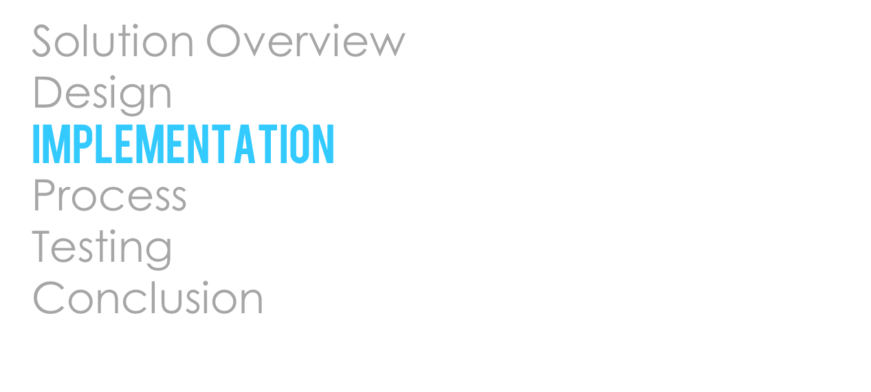

Daren Rodhouse & Blayne Kennedy

Slide 17
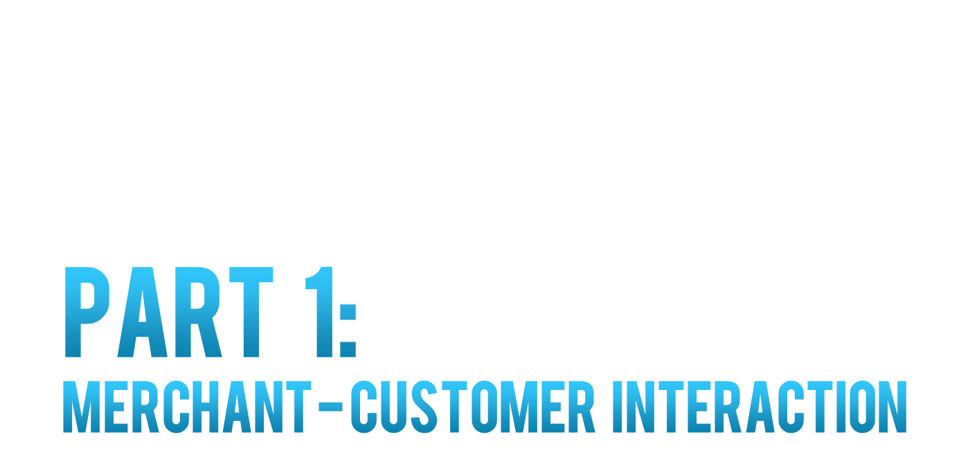



Slide 18

Merchant
Customer
Notes:
CHIHI

Slide 19
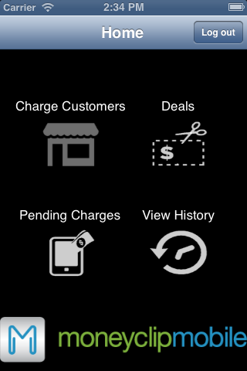
Merchant
Customer
Notes:
CHIHI

Slide 20
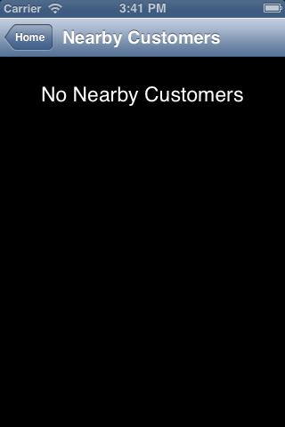
Merchant
Customer
Notes:
CHIHI

Slide 21
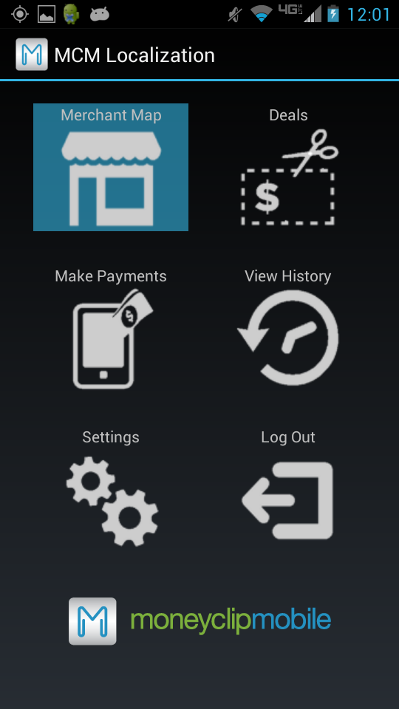
Merchant
Customer
Notes:
CHIHI

Slide 22
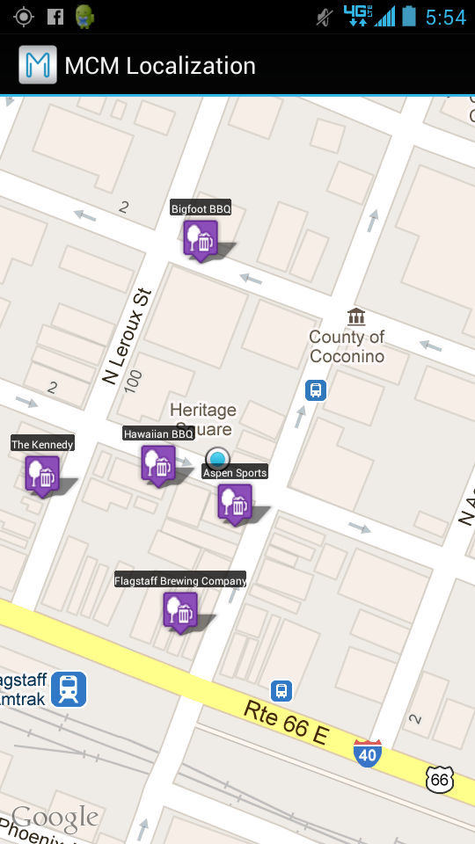
Merchant
Customer
Notes:
CHIHI

Slide 23
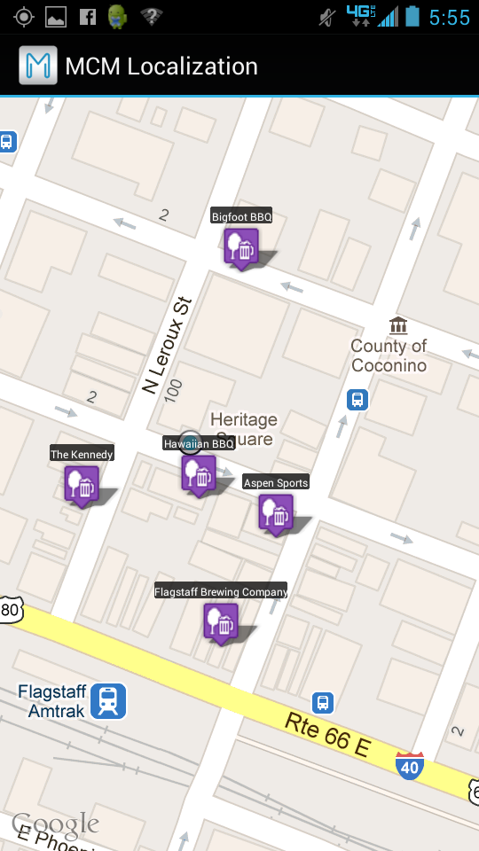
Merchant
Customer
Notes:
CHIHI

Slide 24
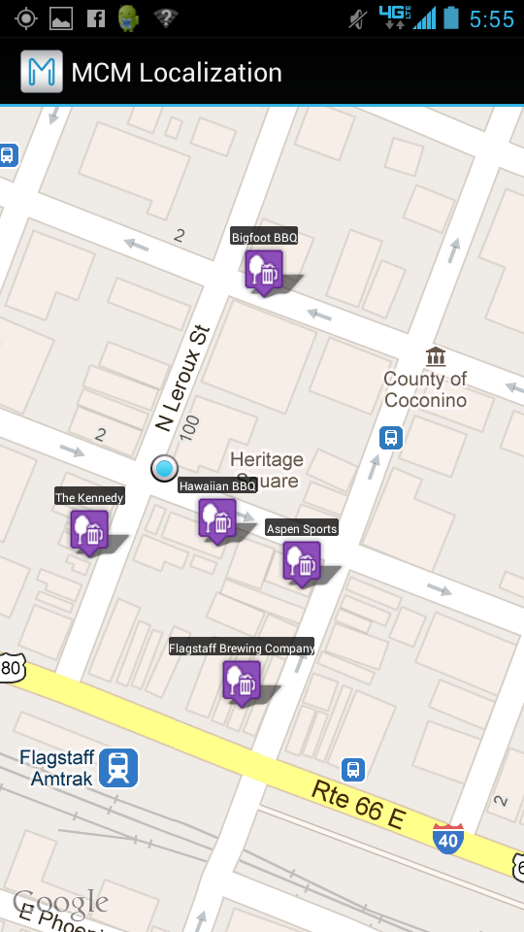
Merchant
Customer
Notes:
CHIHI

Slide 25
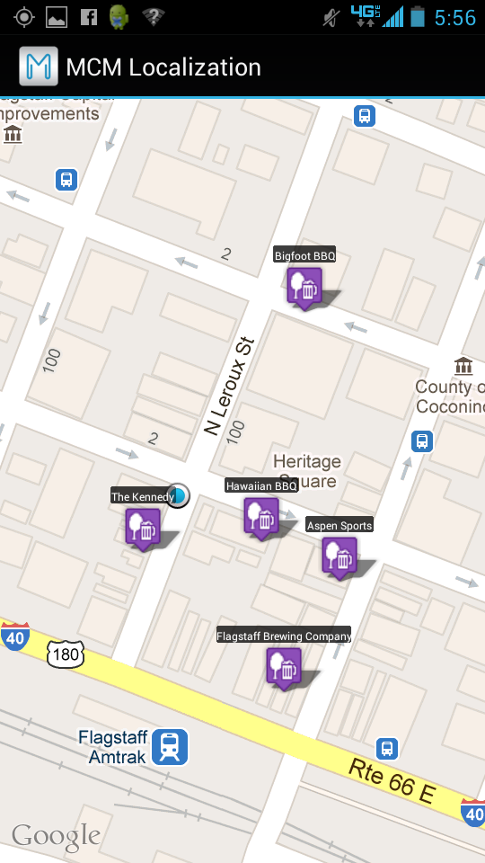
Merchant
Customer
Notes:
CHIHI

Slide 26

Merchant
Customer
Notes:
CHIHI

Slide 27
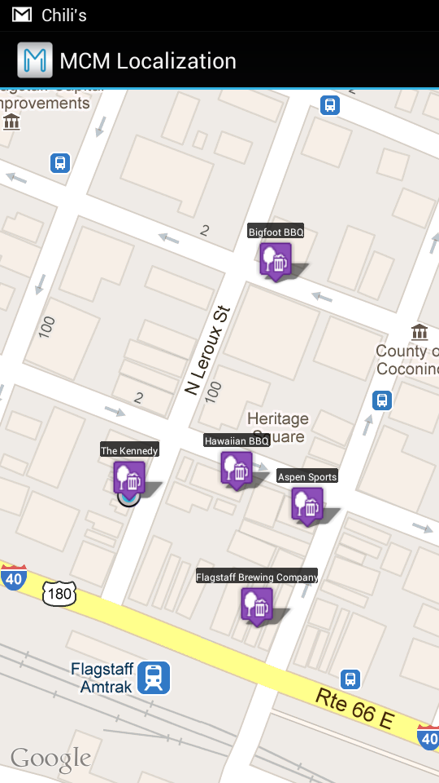
Merchant
Customer
Notes:
CHIHI

Slide 28
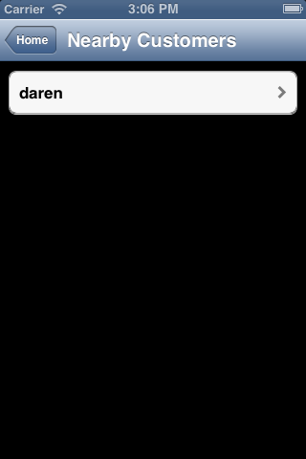
Merchant
Customer
Notes:
CHIHI

Slide 29
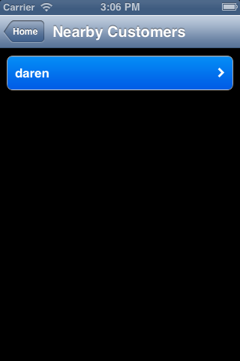
Merchant
Customer
Notes:
CHIHI

Slide 30
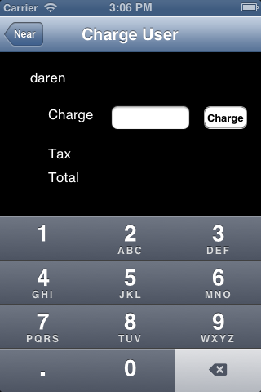
Merchant
Customer
Notes:
CHIHI

Slide 31
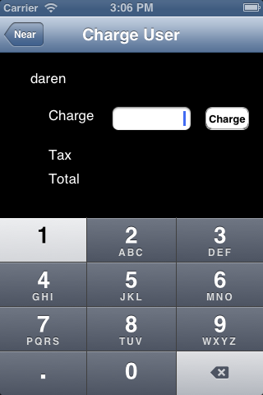
Merchant
Customer
Notes:
CHIHI

Slide 32
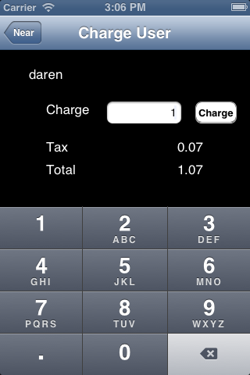
Merchant
Customer
Notes:
CHIHI

Slide 33
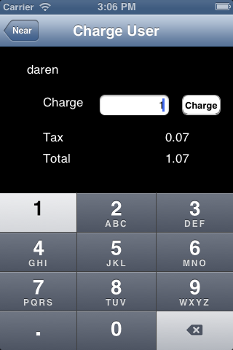
Merchant
Customer
Notes:
CHIHI

Slide 34

Merchant
Customer
Notes:
CHIHI

Slide 35
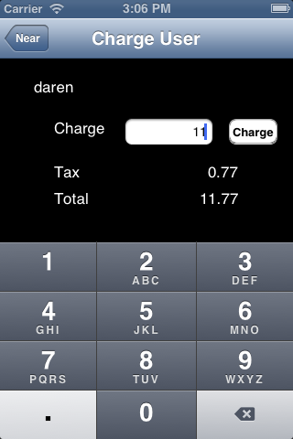
Merchant
Customer
Notes:
CHIHI

Slide 36

Merchant
Customer
Notes:
CHIHI

Slide 37
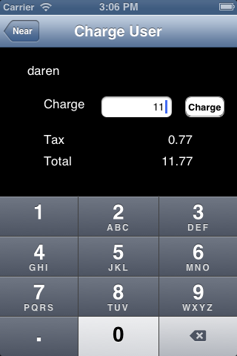
Merchant
Customer
Notes:
CHIHI

Slide 38

Merchant
Customer
Notes:
CHIHI

Slide 39

Merchant
Customer
Notes:
CHIHI

Slide 40

Merchant
Customer
Notes:
CHIHI

Slide 41
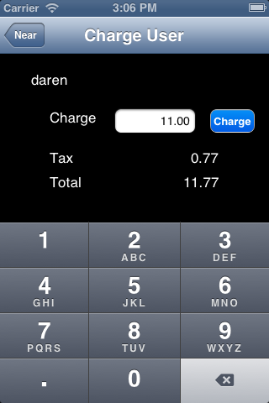
Merchant
Customer
Notes:
CHIHI

Slide 42
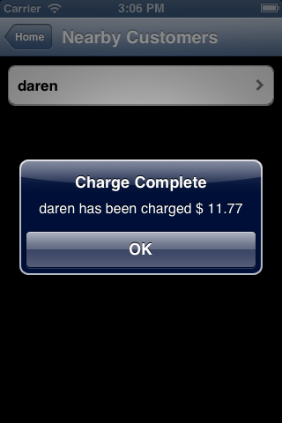
Merchant
Customer
Notes:
CHIHI

Slide 43
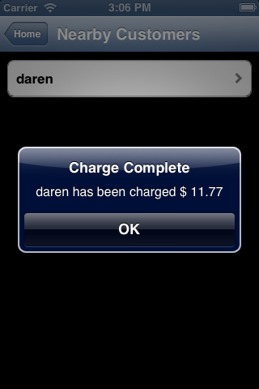
Merchant
Customer
Notes:
CHIHI

Slide 44
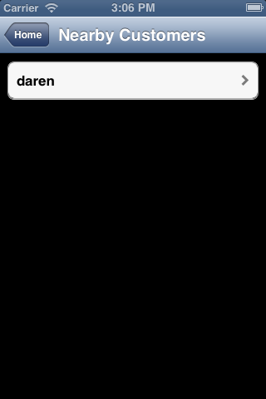
Merchant
Customer
Notes:
CHIHI

Slide 45
Merchant
Customer
Notes:
CHIHI

Slide 46
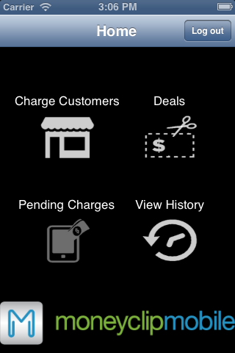
Merchant
Customer
Notes:
CHIHI

Slide 47
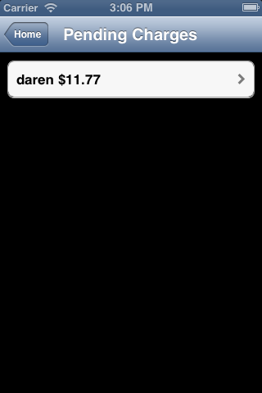
Merchant
Customer
Notes:
CHIHI

Slide 48
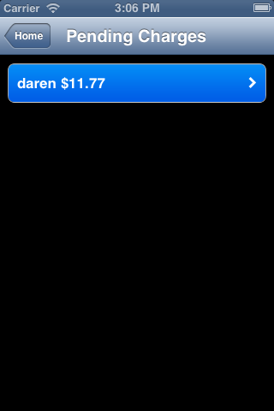
Merchant
Customer
Notes:
CHIHI

Slide 49
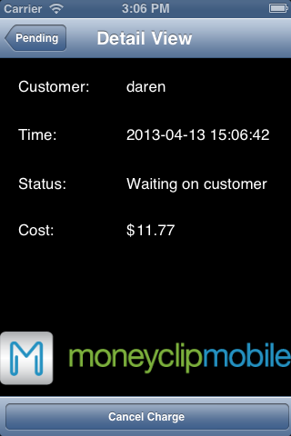
Merchant
Customer
Notes:
CHIHI

Slide 50
Merchant
Customer
Notes:
CHIHI

Slide 51
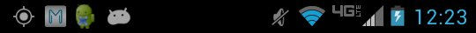
Merchant
Customer
Notes:
CHIHI

Slide 52
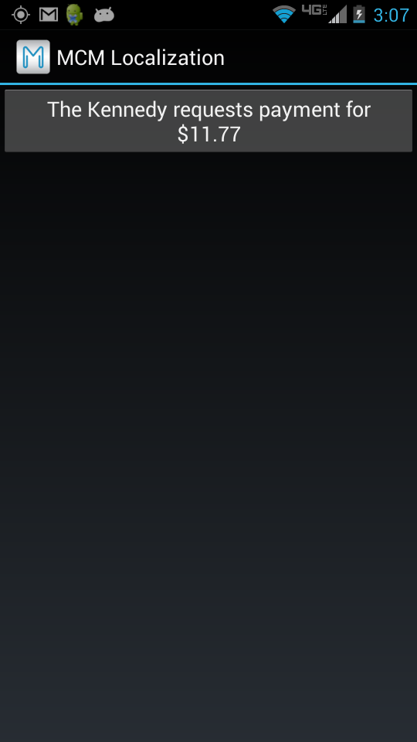
Merchant
Customer
Notes:
CHIHI

Slide 53
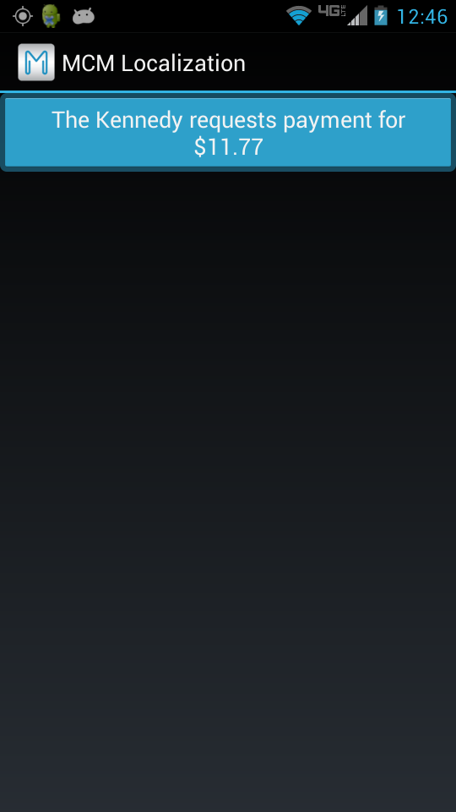
Merchant
Customer
Notes:
CHIHI

Slide 54
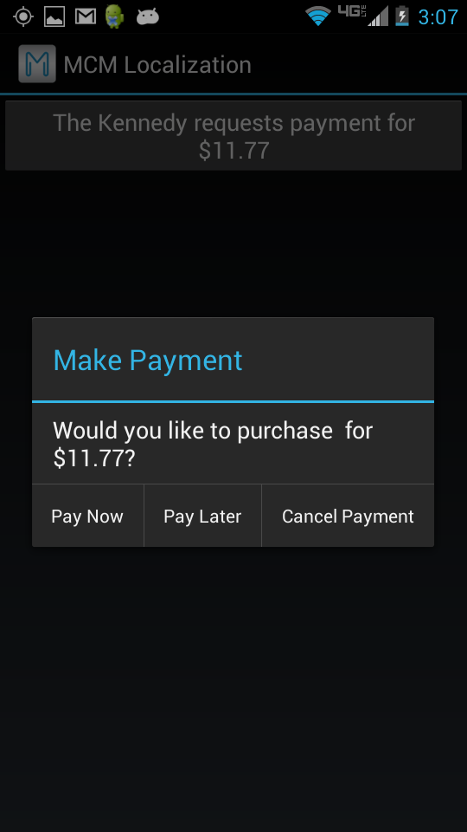
Merchant
Customer
Notes:
CHIHI

Slide 55
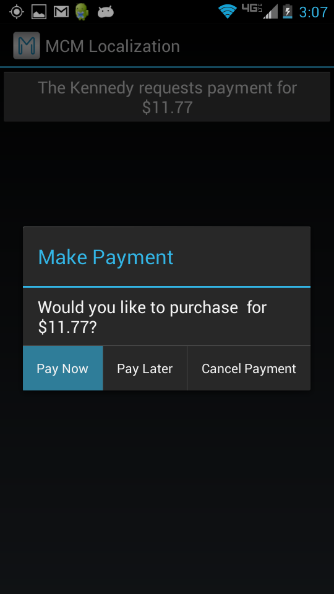
Merchant
Customer
Notes:
CHIHI

Slide 56
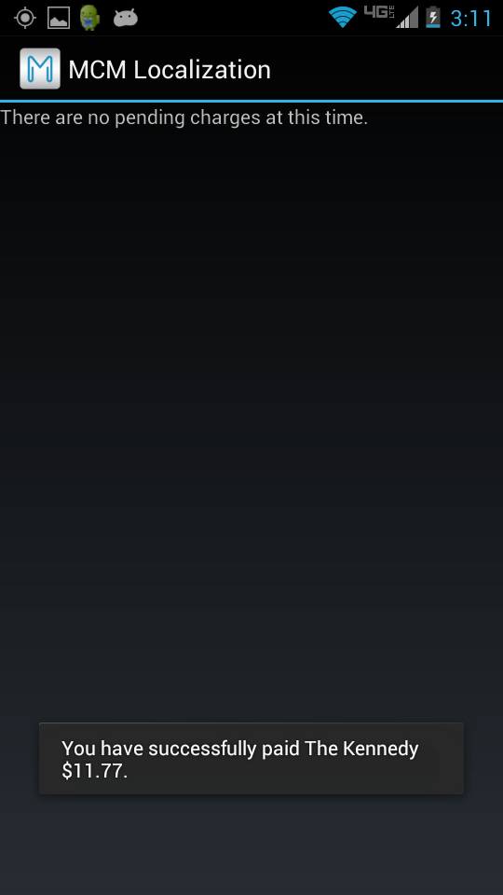
Merchant
Customer
Notes:
CHIHI

Slide 57
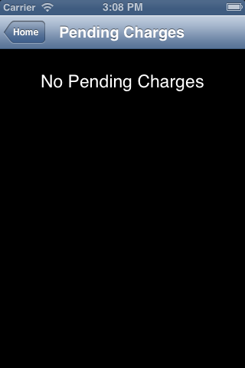
Merchant
Customer
Notes:
CHIHI

Slide 58
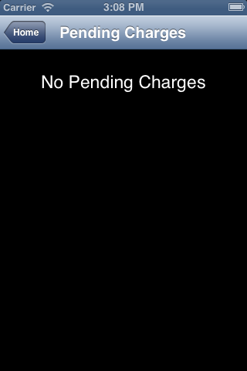
Merchant
Customer
Notes:
CHIHI

Slide 59

Merchant
Customer
Notes:
CHIHI

Slide 60
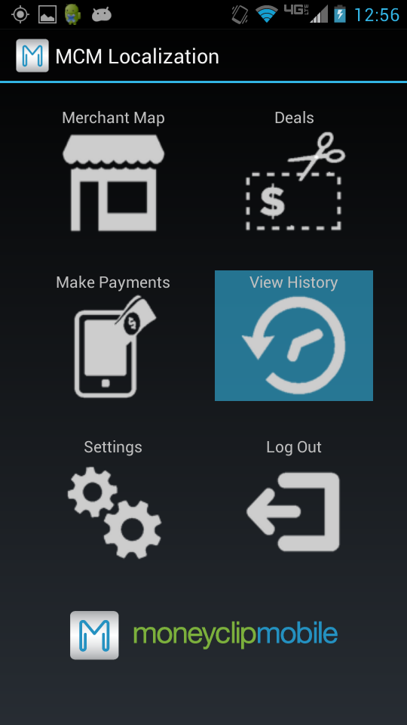
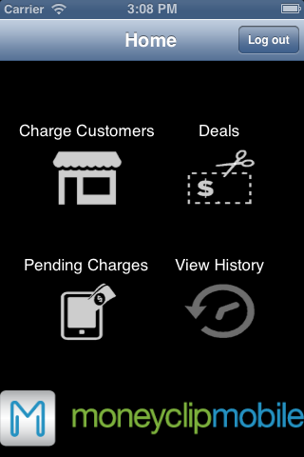
Merchant
Customer
Notes:
CHIHI

Slide 61
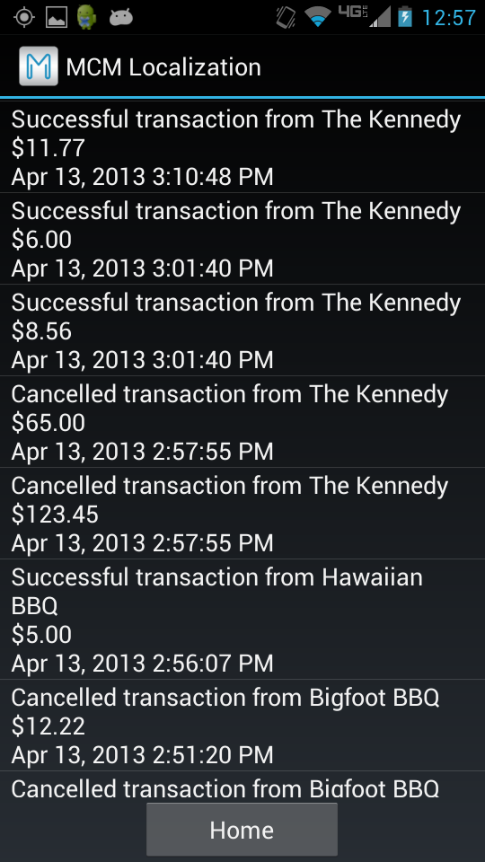
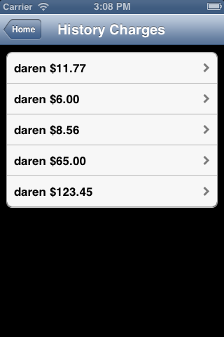
Merchant
Customer
Notes:
CHIHI

Slide 62
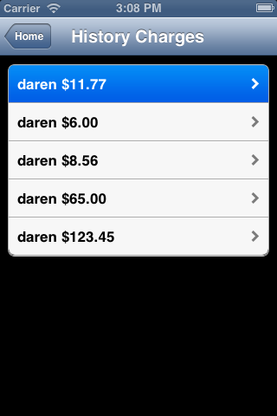
Merchant
Customer
Notes:
CHIHI

Slide 63
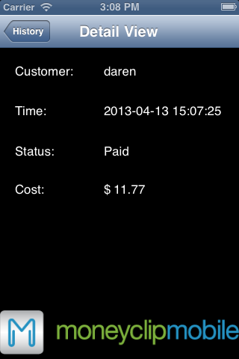
Merchant
Customer
Notes:
CHIHI

Slide 64



Slide 65

Customer
Notes:
CHIHI

Slide 66
Customer
Notes:
CHIHI

Slide 67
Customer
Notes:
CHIHI

Slide 68
Customer
Notes:
CHIHI

Slide 69
Customer
Notes:
CHIHI

Slide 70
Customer
Notes:
CHIHI

Slide 71
Customer
Notes:
CHIHI

Slide 72
Customer
Notes:
CHIHI

Slide 73
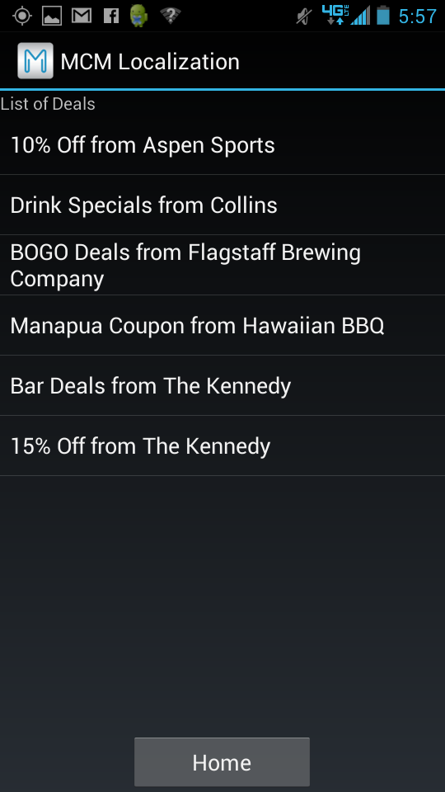
Customer
Notes:
CHIHI

Slide 74

Customer
Notes:
CHIHI

Slide 75

Customer
Notes:
CHIHI

Slide 76


Blayne Kennedy

Slide 77


Scrum Development Process
Week-long development cycle
GitHub Repository
Notes:
Development process
Started with basic app functionality
Next came web services
Then localization feature for customer-merchant interaction
Finally we did the localization feature for targeted deals.

Slide 78



YouTrack
Reports show progress
Notes:
Task Board

Slide 79



Slide 80


Chihiro Sasaki

Slide 81


Tested web services
Database structures
Query syntax
GPS Accuracy
Notes:
For part of testing, we performed a series of integration testing. We verified that the preconditions and postconditions held true for queries in the web services. We also tested our GPS accuracy for both the Android and iPhone.

Slide 82



4 apps
3 stages of testing
40 volunteer test users
Notes:
We also performed user testing for all four of our apps. We conducted these in 3 stages, where we first had two alpha users test the scenarios, and incorporated changes to the apps based on their feedback. We had a slightly larger set of users in the next stage, where more changes were made. For our final user testing, we had more than 32 people testing our system, where we borrowed Dr. Doerry’s UI equipment to record the tests. We had each pair of users to perform a set of tasks, as you can see on the right image, and these events were recorded on video, which can be monitored in the room next door, as you can see in the left image.

Slide 83


Consistent app behavior
Expected functionalities
Notes:
We got very important feedback from our user testing, and one of the important ones was for the merchant map page on the customer app. As you could see from the video, many users wanted the map page to do something other than simply display the names of the merchants. For this case, the apps really need to meet the expected functionalities of the user, and also have consistent behavior on all pages.

Slide 84

Action | Android (KB) |  | iPhone (KB)
 | Receive | Transmit | Receive | Transmit
Log in | 2.322 | 3.100 | 0.433 | 0.592
Merchant Map | 1.942 | 1.912 | 1.804 | 1.703
Deals | 3.328 | 1.002 | 1.692 | 0.571
Pay Charge | 0.942 | 1.740 | 0.298 | 0.283
View History | 2.070 | 0.872 | 4.226 | 0.570
Logout | 0.000 | 0.000 | 0.000 | 0.000
Notes:
Shown here are the data transfer sizes for the Android and iPhone customer apps. The reason the Android takes more data during login is because it pulls a set of data to be stored on the phone for the remaining session.

Slide 85


Kimberly Oyama

Slide 86

GPS accuracy
Inaccurate geolocation
Cell coverage
Wi-Fi and network connectivity issues
Performance dependent on network
Scalability problems
Server overload

Slide 87

Comprehensive commerce apps with map and localization functionality
Localization:
Charging users in store perimeter
Targeted deals
Notes:
The MCM localization project is going to combine the moneyless mobile transactions like PayPal and Square, with the addition of direct advertisements and coupons using localization. We currently have the skeleton of the database, both mobile apps, and the website. The first component of localization of the merchant and customer interaction is completed, and we are currently working on direct advertisements as well as testing and thorough documentation.

Slide 88

Dr. Joshua Cross
Dr. John Georgas
Dr. Wolf-Dieter Otte
Dr. Eck Doerry
User Testing Volunteers
Notes:
The MCM localization project is going to combine the moneyless mobile transactions like PayPal and Square, with the addition of direct advertisements and coupons using localization. We currently have the skeleton of the database, both mobile apps, and the website. The first component of localization of the merchant and customer interaction is completed, and we are currently working on direct advertisements as well as testing and thorough documentation.

Slide 89

For more information:
Poster Presentation during
Session 3 from 2:00 to 4:00 p.m.
at SkyDome exihibit 34B

Slide 90

Google Maps API limit
25,000 map loads per day for free
2,500 requests per day for geocoding
Google Maps API for Business
$10,000 per year
100,000 requests per day for geocoding

